Slide 1

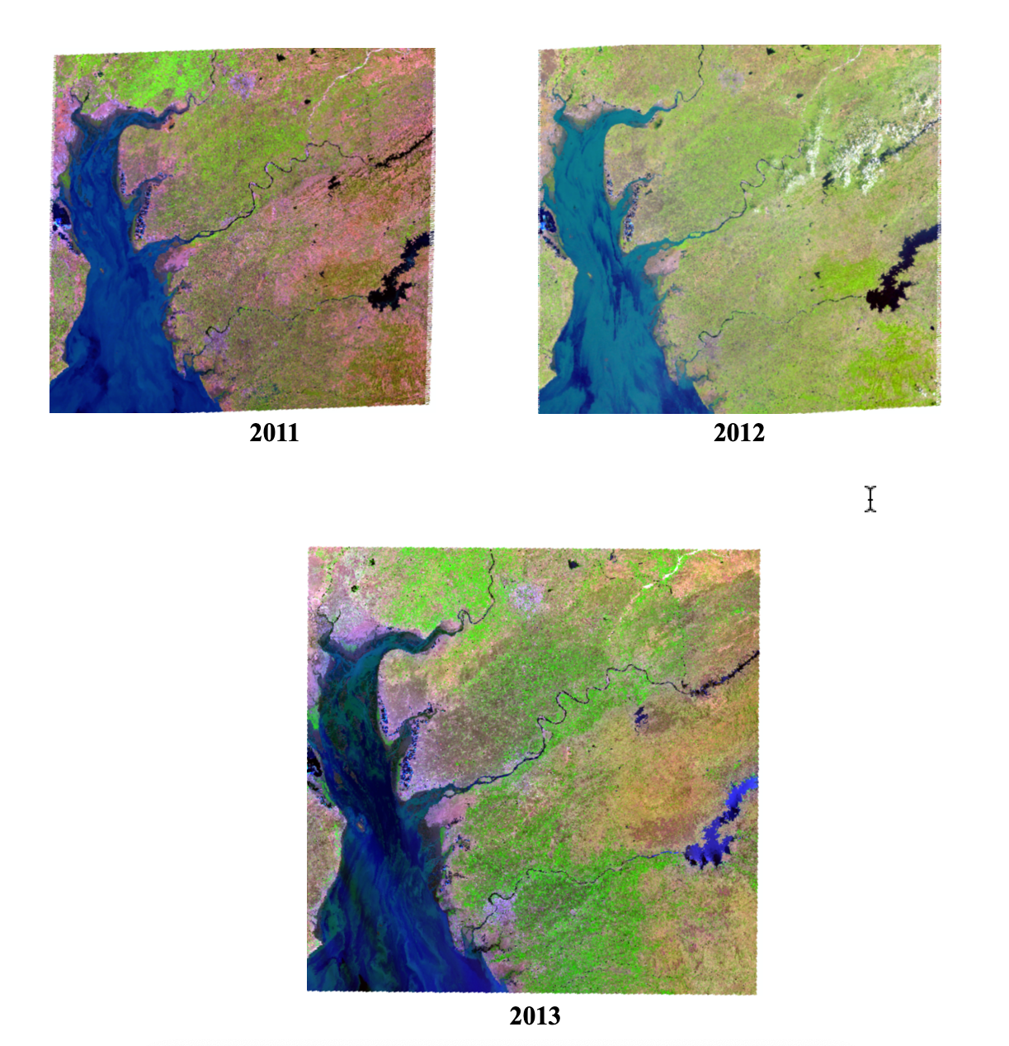
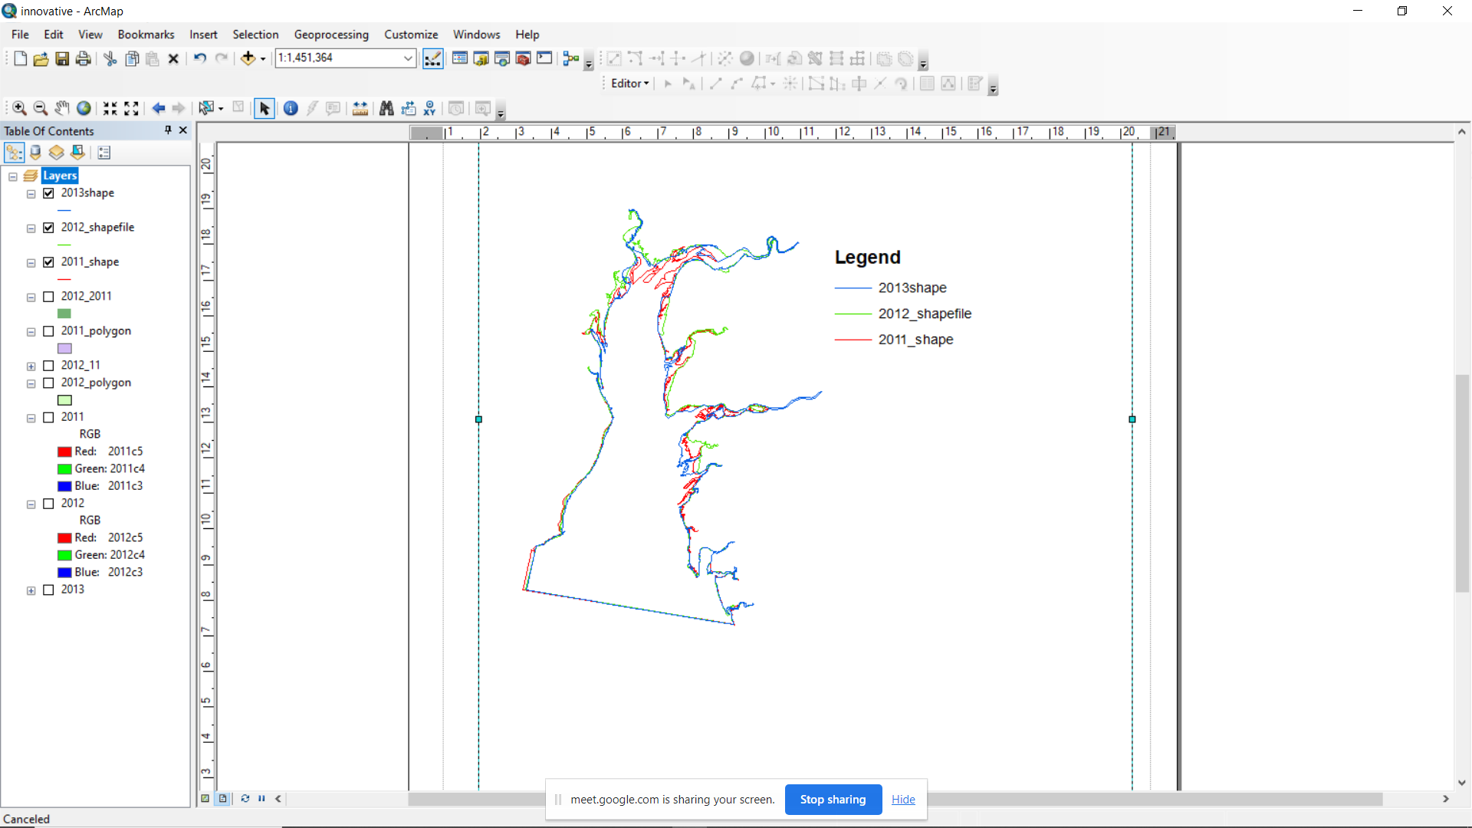
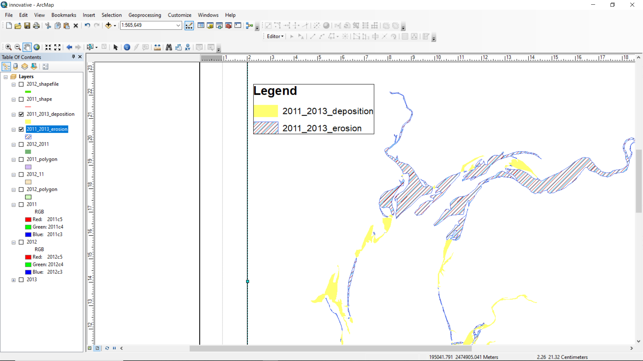
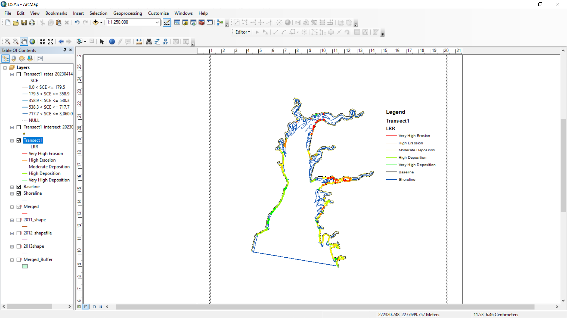

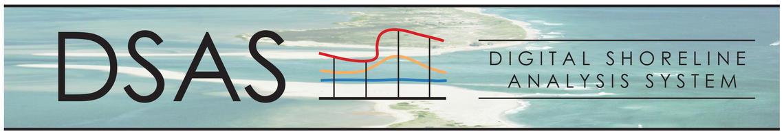

Shoreline Change Analysis for Gulf of Khambhat using ArcGIS
20BCE050, 20BCE066, 20BCE192 and 20BCE204
Abstract
Objective
Coastal phenomena are a significant cause for concern due to their impact on the morphology of shorelines. These changes can result in the transportation of sediment along the coast, making it crucial to identify areas and rates of erosion and deposition caused by wave action. This can be achieved by regularly monitoring the coastline through satellite surveillance. The aim of this study was to assess short-term shoreline modifications between 2011 to 2013 in the Gulf of Khambhat, using half-yearly periodic intervals. The research employed Remote Sensing datasets from USGS and conducted imagery analysis using ArcGIS and DSAS.
The region of interest selected for this project is Gulf of Khambhat shoreline of Gujarat, India. This shoreline is present in coastal region Saurashtra of Gujarat. The objective of the project is to calculate shoreline changes happened in various years and calculating area of erosion and deposition. This task has been performed for various years with a time gap of 1 year from 2011 to 2013.The satellite used for this purpose is LANDSAT-5 and LANDSAT-8.
Methodology
USGS earth explorer
Landsat 5,8
Shoreline image
Calculating Area of Erosion and Deposition
Satellite images
Calculating Rate of change of Shoreline
Satellite images of Gulf of Khambhat
Polyline shapefiles of shorelines of different years
Expected Results
Created Polyline and polygon shapefiles
Calculated Area of erosion and deposition for consecutive years
Computed Rate of shoreline change using DSAS Tool
Area of Erosion and decomposition
Rate of Shoreline Change using DSAS
Outcomes
Bibliography/ References
DSAS tool https://youtu.be/hYmNz9mkN2I
ArcGIS https://youtu.be/BbUctneHfKc
Band composite and Mosaic https://youtu.be/I5sa24JjC2A
USGS Link https://earthexplorer.usgs.gov/
DATE | AREA OF EROSION (km2 ) | AREA OF DEPOSITION (km2 )
30/1/11-14/11/11 | 596.62 | 84.71
14/11/11- 25/04/13 | 59.58 | 599.01
30/01/11-25/04/13 | 300.97 | 312.72
Acknowledgement
We would like to express our deep gratitude to Professor Keval Jodhani and Professor Nitesh Gupta , for their patient guidance, enthusiastic encouragement, and
useful critiques of this work.

